Slide 1
Workforce Solutions Program
Informational Webinar
Tuesday, March 3, 2026
10:00-11:00am

Slide 2

Presentation Overview​​
What is Workforce Solutions?
Eligibility and Funding
Grant Calculator Examples
Ineligible Businesses
Business Location
Application Process
Reimbursements
Visits & Monitoring
Closeout Steps
FAQs
Additional Resources
Q & A

Slide 3


What is Workforce Solutions?
Workforce Solutions Grants cover qualified training for current employee upskilling and new hire on-the-job (OJT) training, leadership development, technology skills, and more!
Workforce Solutions reimbursement grants are funded through the City of Chicago via:
Tax Increment Financing (TIF)
Proceeds from the Housing and Economic Development Bond
Grants may fund up to 100% of eligible expenses for businesses seeking to train current employees and/or new hires.

Slide 4
Eligibility Requirements
Located in, expanding into, or relocating to the City of Chicago
Workforce training for W-2 permanent full-time and/or permanent part-time staff
Commitment to remain in community area for at least three years
Financially prepared to support training costs
$250,000 grant limit with 3 year waiting period after limit is reached

Slide 5

Eligible Industries
Nonprofits
Food Service, Tourism and Hospitality
Healthcare and Life Sciences
Manufacturing and Industrial
Information Technology
Real Estate, Finance, Insurance
Retail
Energy
Education and Training
Transportation, Distribution and Logistics
This list is not all inclusive – if you have questions about your industry, please contact the Workforce Solutions Program Director

Slide 6
What will Workforce Solutions Fund?
The Workforce Solutions program can fund trainings for:
  Current employees
  New hire on-the-job training (Chicago residents only) *
  Leadership Development
  Instructor Wages/Trainer’s fee (for incumbent worker training)
  Training supplies/materials (items associated with direct training costs)
  Training rental equipment
  Customized Training Curriculum

Slide 7
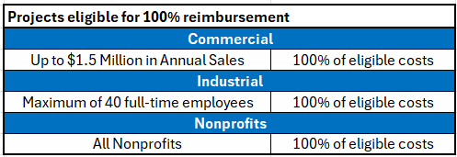
Funding Overview
The Workforce Solutions Program is a reimbursement grant that can fund:
Up to 100% of total eligible project costs up to a standard maximum of $250,000.

Slide 8
Funding Overview (cont.)
Contribution "Match" is based on business size.
Contributions may include expenses not already included in the project costs such as:
  Wages for staff used to assist with training
  Materials and supplies used to support training
  Wages paid to incumbent employees during training

Slide 9
Grant Calculator: Example 25% Match/Contribution
Lori submits an application for the Workforce Solutions Grant in an open TIF/Community Area. She is proposing training with a total eligible cost of $100,000 for incumbent worker training. Over the past 3 years Lori’s hospitality business has grossed $4 million in annual sales.
The breakdown of Lori’s eligible costs are as follows:​
​
Total Eligible Project Costs: $100,000​
Commercial Business Annual Sales Over $1.5 M/Under $5 M: 25% Business Contribution​
Workforce Solutions Grant: $100,000​
Business Contribution/Employee Investment: $25,000​

Slide 10
Grant Calculator: Example 50% Match/Contribution
Sam submits an application for the Workforce Solutions Grant in an open TIF/Community Area. He is proposing training with a total eligible cost of $200,000 for 20 current employees. Sam’s manufacturing company employs 250 employees.
The breakdown of Sam’s eligible costs are as follows:​
​
Total Eligible Project Costs: $200,000​
Industrial Business Gross Sales +125 Employees = 50% Business Contribution​
Workforce Solutions Grant: $200,000​
Business Contribution/Employee Investment: $100,000​

Slide 11
Grant Calculator: Example 0% Match/Contribution
Jessica applies for Workforce Solutions Grant in an eligible TIF/Community Area. Her Non-Profit Organization serves the homeless at shelters throughout the City of Chicago. She is proposing training with a total eligible cost of $125,000 for incumbent worker training and On-The-Job Training for 2 new hire positions. Over the past 3 years her non-profit has grossed $450,000.
The breakdown of Jessica’s eligible costs are as follows:​
Total Eligible Project Costs: $125,000​
Workforce Solutions Grant: $125,000​
Non-profit Organization: No match required

Slide 12
Ineligible Businesses/Organizations
Chain Businesses
Branch Banks
Employment Agencies
Religious Worship Institutions
Currency Exchanges
Pay Day Loan Stores
Pawn Shops
Astrology/Palm Reading Stores
K-12 Schools
Gas Stations
Residential Run Businesses
Online Only Businesses
Liquor Stores/Bars/Night Clubs
Smoke shops/cigar lounges
Adult Uses
Firearms Stores/Shooting Ranges
Massage Parlors
Hotels or Motels
Residential Storage Warehouse
Track Waging Facilities
Trailer Storage Yards/Junk Yards
*This list is not exhaustive

Slide 13
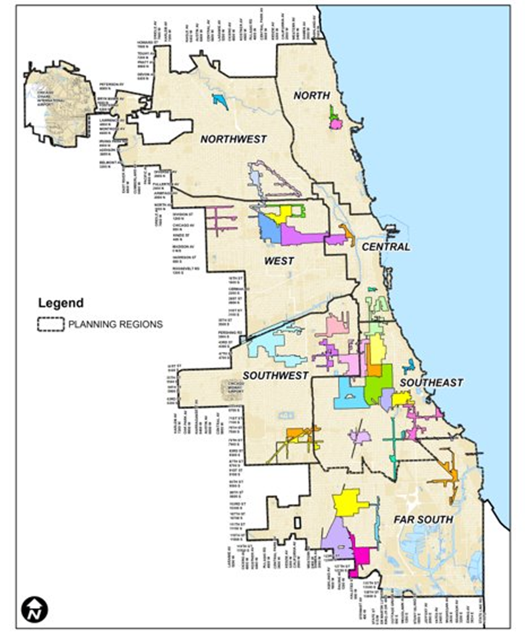
Business Location
Grant program is open to businesses citywide.
Currently funding is available in the 27 TIF districts on next slide.
Applications for the first Cycle of Bond funding closed March 2, 2026. Anyone wanting to apply for Bond now must submit your application between April 1, 2026 to April 30, 2026.
Businesses outside of these districts are encouraged to contact us for guidance on next steps.
  Email us at: workforcesolutions@eesforjobs.com

Slide 14
Business Location
TIF funding requires your business to be in one of the 27 TIF Districts designated for the Workforce Solutions Program. (Note: other funding may be available.)
• 119th/Halsted
• 119th/I-57
• 35th/Halsted
• 47th/Ashland
• 47th/Halsted
• 47th/King Drive
• 47th/State
• 71st/Stony Island
• 79th/Vincennes
• 87th/Cottage Grove
• Austin Commercial
• Avalon Park/South Shore
• Bronzeville
• Chicago/Central Park
• Commercial Avenue
• Elston Armstrong
• Englewood Neighborhood
• Fullerton/Milwaukee
• Greater Southwest (East)
• Kinzie Industrial Corridor
• Lawrence/Broadway
• Pulaski Corridor
• Roseland/Michigan
• Stevenson/Brighton
• Washington Park
• West Woodlawn
• Woodlawn

Slide 15
Business Location
Not in a TIF District?
Apply and E&ES will discuss options for other potential funding opportunities.
In a TIF District with no funding?
Not currently eligible for Workforce Solutions
E&ES will notify you if/when future funding may be available
All are welcome to apply if:
Upskilling and training is needed for your employees
You are hiring new employees to enhance the success of your business

Slide 16
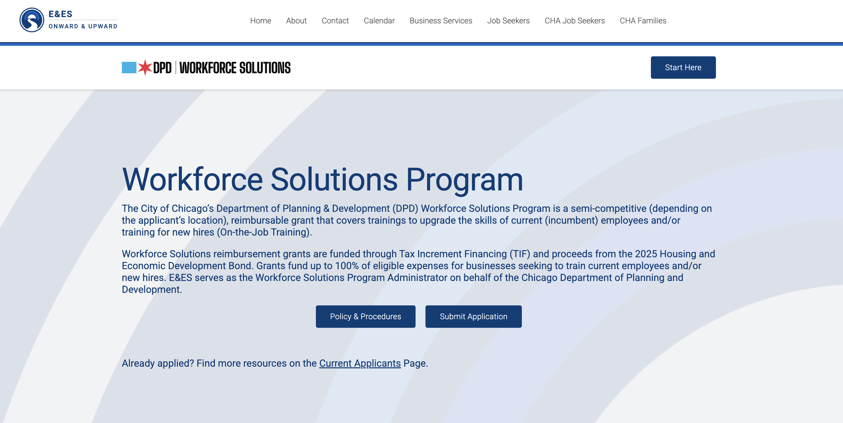
How Do You Apply?

Slide 17
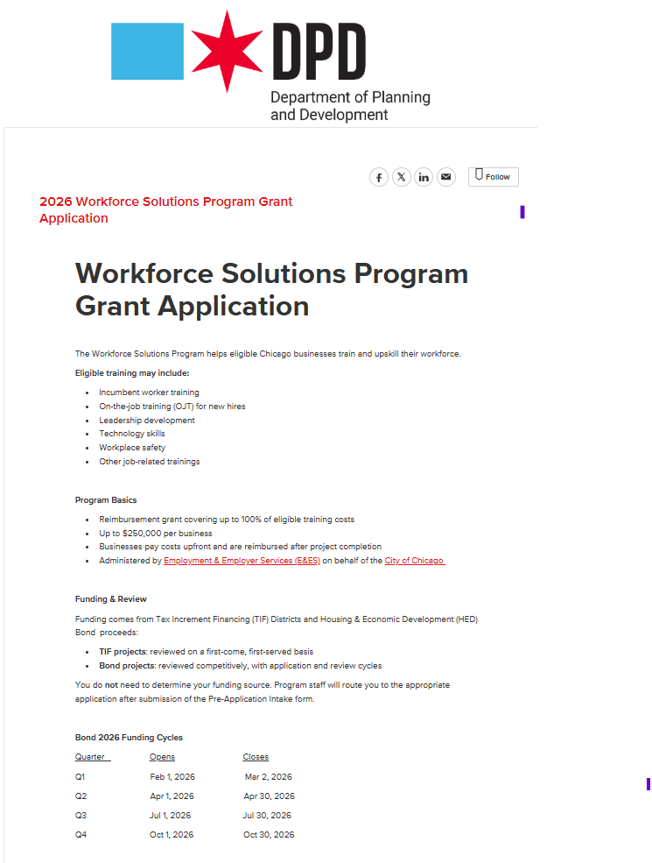
How Do You Apply?
Applicants must apply via Submittable
  https://cocdpd.submittable.com/submit
  Search for: Workforce Solutions Grant Application
Complete the Pre-Application Intake Form
  https://cocdpd.submittable.com/submit/ab74c46c-65f5-4872-8999-008261859fde/2026-workforce-solutions-program-grant-application
The initial application review process to determine pre-eligibility takes approximately 1-2 weeks to complete.

Slide 18
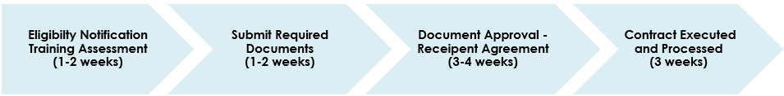
Application Process Steps:
*Timeline is tentative and subject to change – Bond Funded Application Timeline will vary*
Step 1 - After submitting application, applicant is notified of their eligibility via Submittable and asked to
complete a Training Needs Assessment
Step 2 - Applicant proceeds with submitting the required documentation
Step 3 - Once documents are reviewed and approved, E&ES sends applicant the Recipient Agreement to
review and sign
Step 4 - Applicant submits executed Recipient Agreement to E&ES
Step 5 - Applicant is notified that contract has been executed and processed and business receives
conditional award letter. Applicant may begin trainings.

Slide 19

Applicant Approval – Time Sensitive Step
Scofflaw and Indebtedness Check completed during the approval process
  Compliance with Child Support Laws
  Verify no debts owed to the City
  Economic Disclosure Statement
  Note: Applicants with outstanding City of Chicago debt will be required to resolve the debt or demonstrate significant progress toward resolution before the application can move forward.

Slide 20
Required Documentation
Training Needs Assessment
Proof of Revenue
Certificate of Insurance
Program Policies & Procedures
Economic Disclosure Statement
Principal Profile
Child Support Affidavit
Copy of Business License
Monitoring Protocol Requirement
ACH Banking Information
Training Curriculum/Schedule
Training Resumes/References
Training Cost Estimate/Quote
For New Hires: Job Description(s)

Slide 21
Reimbursement for Eligible Costs
Vouchers and documentation can be submitted for reimbursement
  after training sessions are completed,
  and training providers are paid
  or wages are paid for new on-the-job hires.
Frequency:
  Incumbent Worker Training:
    Up to three vouchers may be submitted during the contract term
  On-the-Job Training:
    Monthly for a maximum of 13 weeks (3 months)
    Retention/Close-Out

Slide 22
Reimbursement for Eligible Costs
Step 1
Documents submitted for reimbursement:
Voucher Forms
Invoices
Receipts (if applicable)
Proof of payment
Sign-in sheets for trainings
OJT Only: Proof of wage payment in the form of paystubs
Step 2
Review and approval of submitted documentation by E&ES and DPD.
Reimbursement can take 6-8 weeks, pending voucher and documents
are accurate and complete.

Slide 23
Visits & Monitoring
Agreed upon monitoring and compliance check-ins
Submission of required attendance and wage reports
Scheduled site visits to observe training
Business stays in community for at least three years after having received the grant.
Agreed upon annual follow up discussions for three years to discuss business needs post training.
  Follow ups can include phone calls and/or e-mails.

Slide 24
Closeout Steps
Close Out Report and final voucher documentation must be submitted when all training has been completed.
  Training/business goals will be noted at the start of the contract period
The Close Out Report provides a summary of what the trainings accomplished, their impact, return on investment and any challenges faced throughout the process.
Pending funding grant agreement, applicant may be eligible for a 2% administrative compensation upon completion of the Close Out Report.

Slide 25
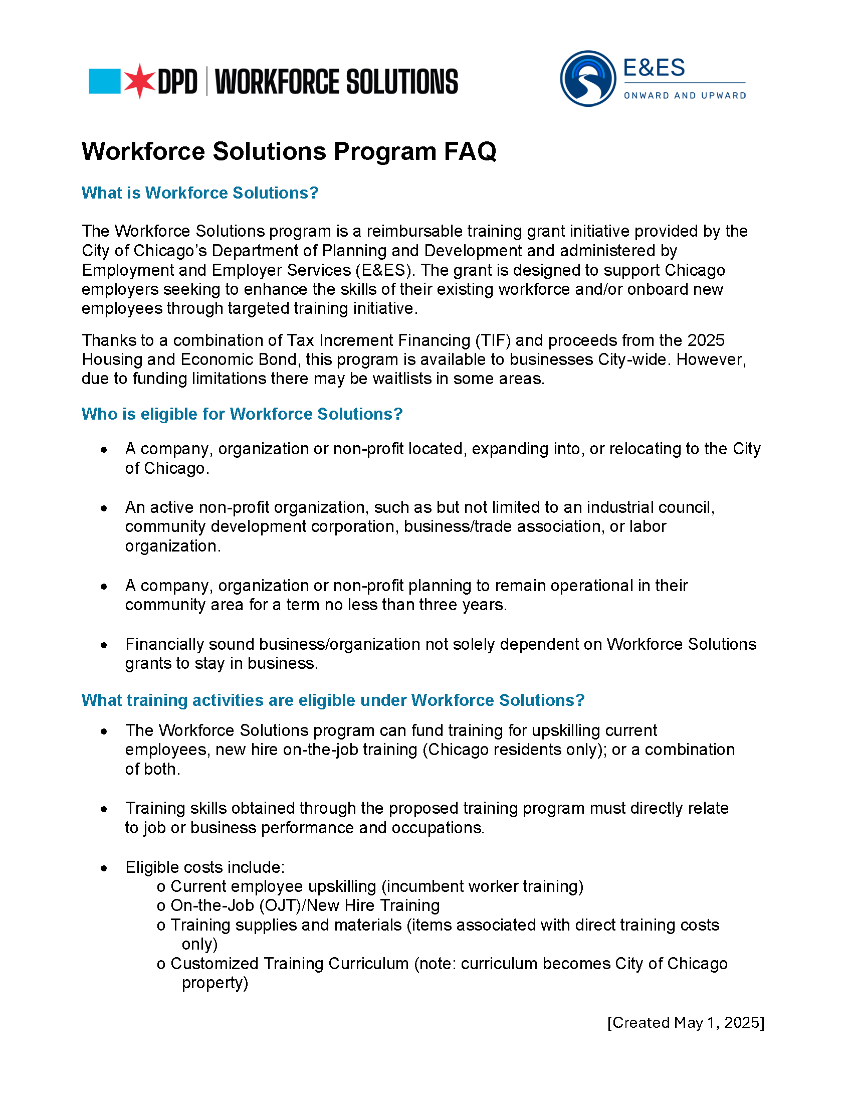
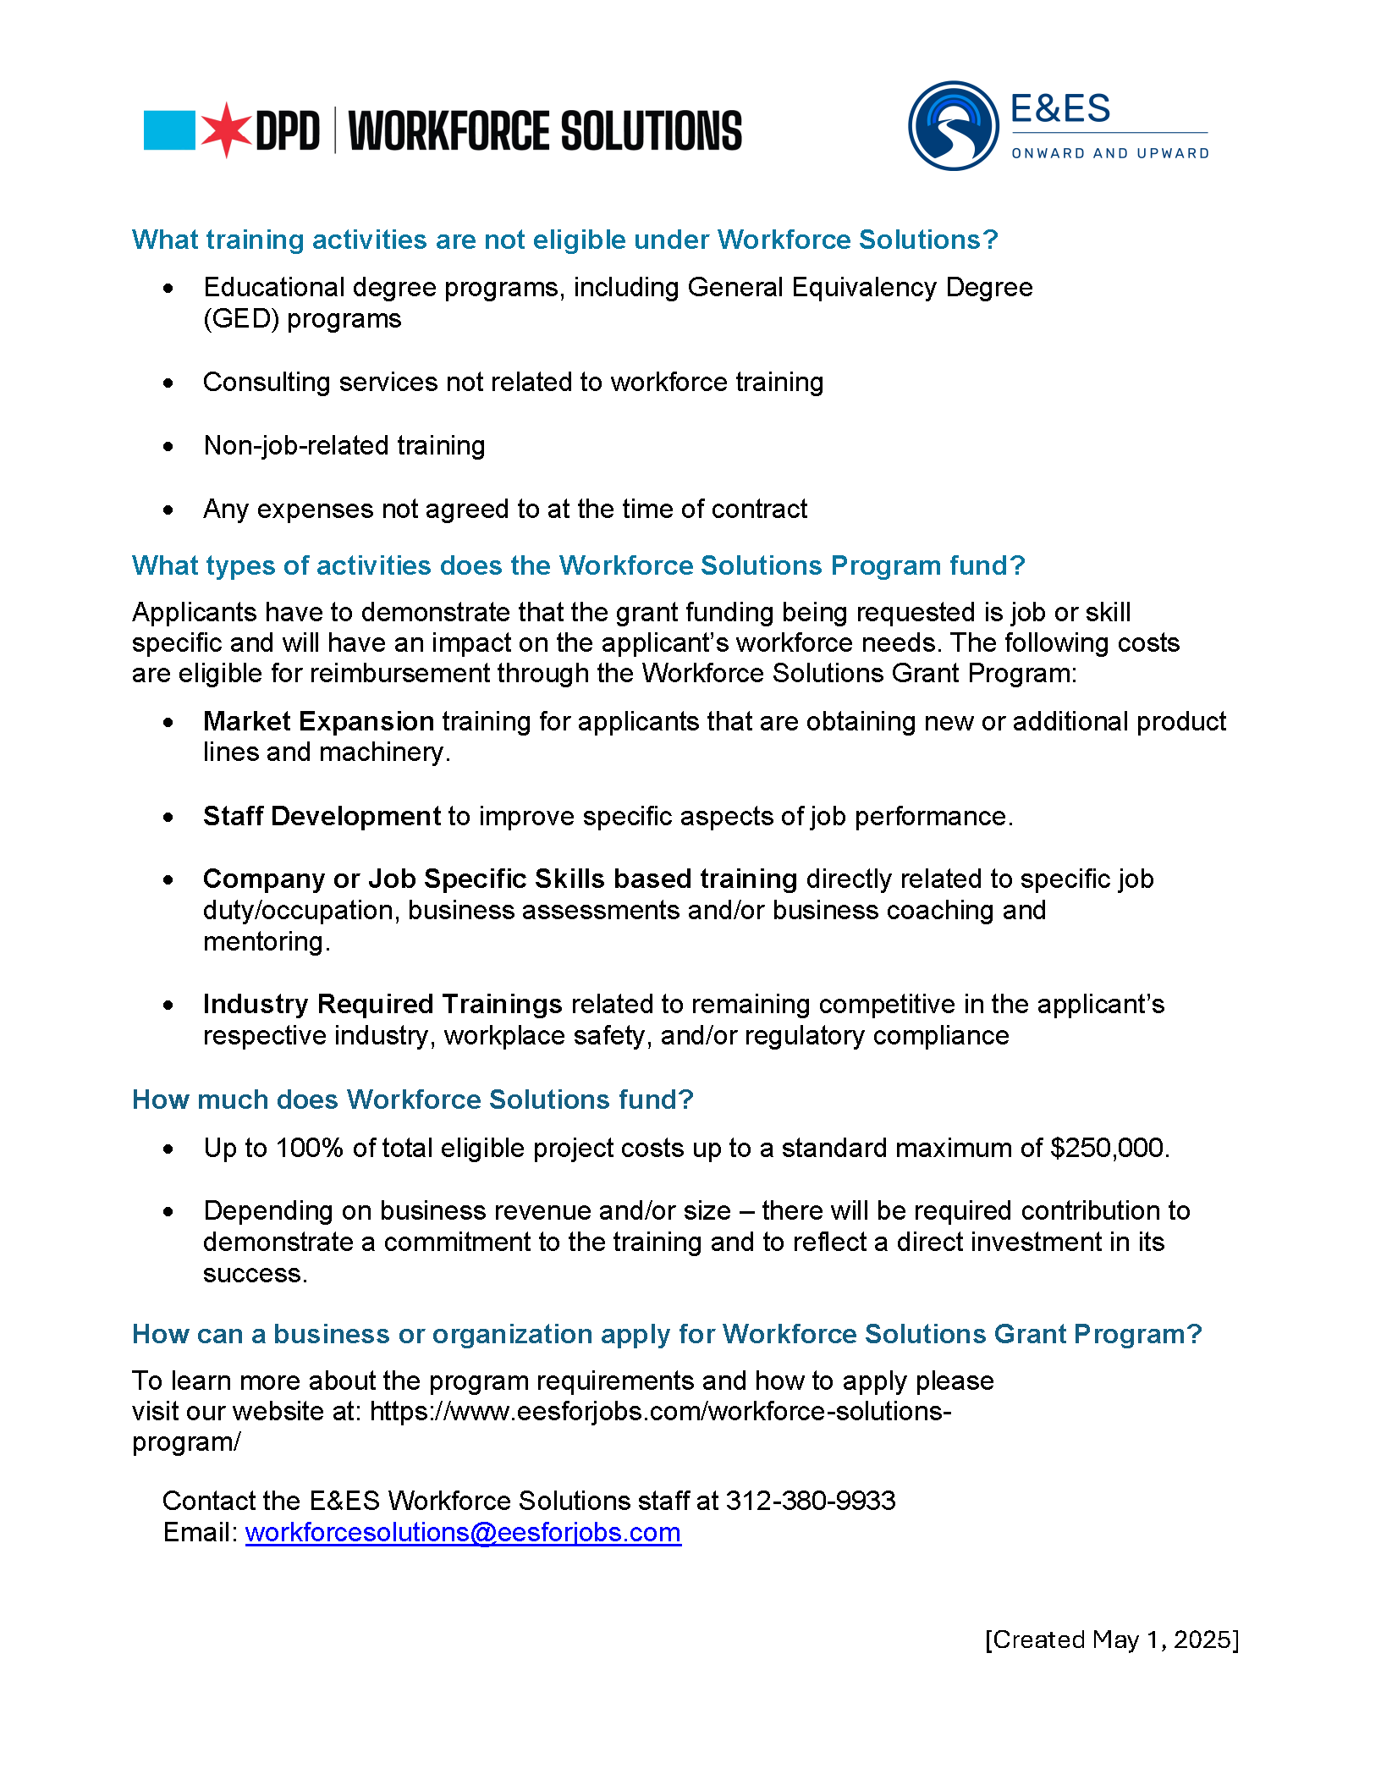
Frequently Asked Questions

Slide 26
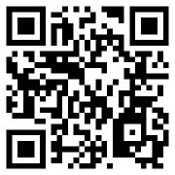
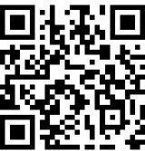
Additional Resources
Small Business Improvement Fund (SBIF)
Grant funding for permanent building improvements and repairs. Program participants can receive grants to cover between 30% and 90% of the cost of remodeling work, with a maximum grant of $150,000 for commercial properties and $250,000 for industrial properties.
Neighborhood Opportunity Fund (NOF)
Leverages funds generated by new development in the Loop to support corridors in Chicago’s underserved neighborhoods. NOF provides grants of up to $250,000 for business and property owners to pay for the construction or rehabilitation of properties that support new or expanding businesses or cultural assets.
Chicago.gov/SBIF
Chicago.gov/NOF

Slide 27
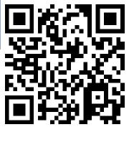
Additional Resources
Community Development Grant (CDG)
Cover eligible new construction and renovation through proceeds from the 2024 Housing and Economic Development Bond and other funding sources. CDGs are available at three funding levels to support local commercial and light manufacturing projects via Small, Medium and Large grants.
Business Affairs and Consumer Protection (BACP)
Chicago.gov/CDG
Serves as a key resource for Chicago businesses, offering guidance, training, and webinars to support growth and compliance.
Learn more about BACP programs and services by visiting: Chicago.gov/BACP

Slide 28


Questions and Answers?
Program Contact Information:
Audrey Johnson
Program Director
(312) 380-9933​
workforcesolutions@eesforjobs.com​
https://www.eesforjobs.com/workforce-solutions-program/​
Lijia Evariz
Coordinator of Economic Development​
Lijia.Evariz@cityofchicago.org​
www.Chicago.gov/WorkforceSolutions

